Slide 1
Protozoa
Cyclospora cayetanensis
Balantidium coli
Entamoeba histolytica
Giardia lamblia
Toxoplasma gondii
Cryptosporidium

Slide 2
Cyclospora cayetanensis
BY: Vanessa Lopez

Slide 3
Where does it naturally live? Soil? Natural environment?
Cyclospora is spread when people ingest water or food contaminated with infected stool.
This protozoan lives out its lifecycle intracellular within the hosts cell epithelial cells and gastrointestinal tract.

Slide 4
Region where it can be found.
The first published report of cyclospora in humans appears to be by Ashdord in 1979.
He found unindetified coccocia in the feces of three individuals in Papua, New Guinea.

Slide 5
Reservoir
Currently, no animal model exist for the study of this pathogenic parasite and the only confirmed reservoir host for this protozoan in nature is humans.

Slide 6
Host Range
The full host range of C. cyaetaneis is currently unknown. Infection with C cayetanesis begins when ingested particles invade the epithelial cells of the small intestine.

Slide 7
Predisposing & Occupational Risks
Disease? Infectious Dose?
Cyclospora infects the small intestine and usually causes watery diarrhea, bloating, increased gas , stomach cramps, loss of appetite, and nausea.
Some people who are infected with cyclospora do not have any symptoms until after infection.

Slide 8
Risk?
Cyclospora has been associated with Guillain-Barre syndrome , reactive arthritis or Reiter’s syndrome, and acalculous cholecystitis. These are more common if you have not been treateed.

Slide 9
Mode of transmission?
Trasmited by ingesting cyclospora oocytes in wither contaminated food or water.Outbreaks in the U.S have been seen in imported fresh produce.

Slide 10
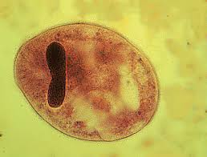
Balantidium coli
Miguel Madrigal
Notes:
Balantidium coli is an intestinal protozoan parasite that causes the infection called balantidiasis.
While this type of infection is uncommon in the United States, humans and other mammals can become infected with Balantidium coli by ingesting infective cysts from food and water that is contaminated by feces.
Mostly asymptomatic, Balantidium infection can cause such symptoms as diarrhea and abdominal pain.

Slide 11
Environment
Tropical
Subtropical
Developing Countries
Notes:
pigs are an animal reservoir, human infections occur more frequently in areas where pigs are raised, especially if good hygiene is not practiced.

Slide 12
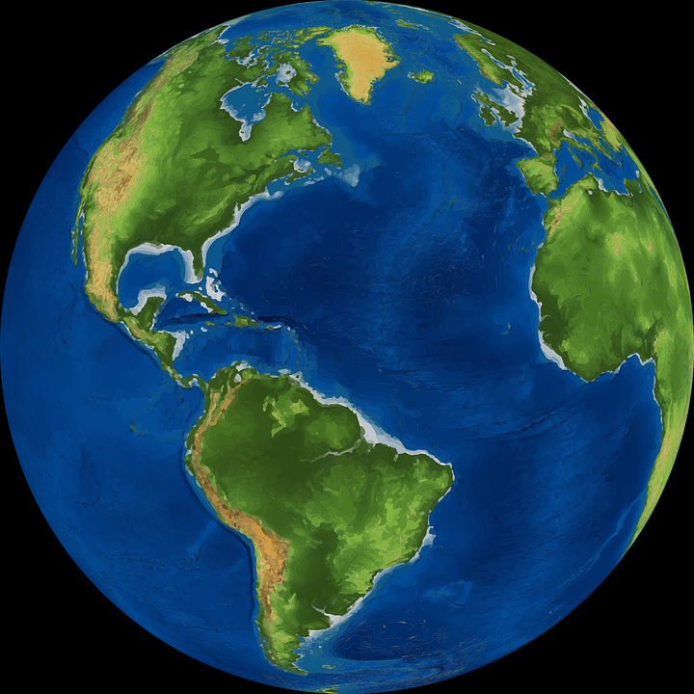
Location
Parasite found worldwide
Incidences found in
  China
  Philippines
  Middle East

Slide 13
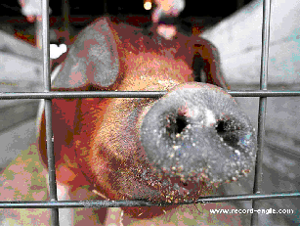
Reservoir
Swine
20-100% prevalence of infection
Asymptomatic carriers
Found in large intestine

Slide 14
Host Range
Humans
Swine
Monkeys
Notes:
Several Balantidium spp. have been recorded throughout the world in various species of crustacea, insects, fish, amphibia and mammals (including humans). Infections by B. coli are particularly prevalent in pigs, monkeys and humans, especially in the tropics, with zoonotic transmission frequently implicated by epidemiological studies.

Slide 15
Predisposing Risks
Tropical/Subtropical regions
Poor hygiene
Crowded institutional living
Malnourished
Immunocompromised

Slide 16
Occupational Risks
Pig Farmers
Veterinarians
Zookeepers

Slide 17
Infectious Dose
Unknown, expected to be low

Slide 18
Mode of Transmission
Transmitted via Fecal-Oral Route
eating meat, fruits, and vegetables that have been contaminated by an infected person or contaminated by fecal matter from an infected animal
drinking and washing food with contaminated water
poor hygiene habits
Notes:
Cysts are the parasite stage responsible for transmission of balantidiasis . The host most often acquires the cyst through ingestion of contaminated food or water . Following ingestion, excystation occurs in the small intestine, and the trophozoites colonize the large intestine . The trophozoites reside in the lumen of the large intestine of humans and animals, where they replicate by binary fission, during which conjugation may occur . Trophozoites undergo encystation to produce infective cysts . Some trophozoites invade the wall of the colon and multiply. Some return to the lumen and disintegrate. Mature cysts are passed with feces .

Slide 19
Work Cited
https://www.cdc.gov/parasites/balantidium/biology.html
https://web.stanford.edu/group/parasites/ParaSites2003/Balantidium/Animal_Reservoir.htm
https://www.canada.ca/en/public-health/services/laboratory-biosafety-biosecurity/pathogen-safety-data-sheets-risk-assessment/balantidium-coli-pathogen-safety-data-sheet.html

Slide 20
Entamoeba histolytica internal-amoeba tissue lysis
Discovered by Lӧsch in 1875
Jennifer Gonzales

Slide 21
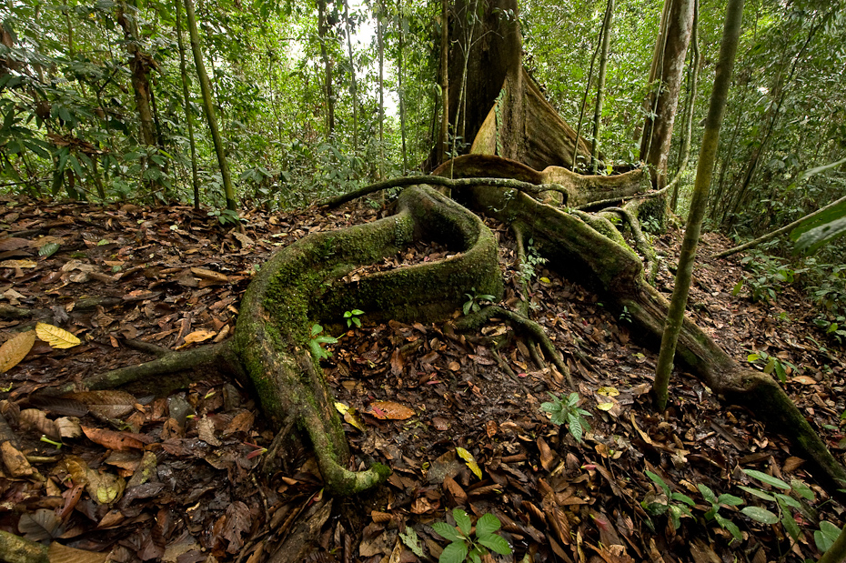
Environment
Tropical
  Low soil fertility
  Warm climate
  Water availability
  Original soil
Tropical environment increases microbial growth, chemical reaction times, and leaching of soluble soil nutrients.
This Photo by Unknown Author is licensed under CC BY-NC-SA
Notes:
Tropical climates are a prime laying ground for microbial growth, They provide a setting for diverse microbial niches and evolution. Communities of microbes can be characterized by these ecotypes and functions. A tropical environment vs a derssert environment are incredibly diverse and retain untold biotechnology potential. Tropical envirnments are mostly in developing countries which leeway for poor sanitation and hygiene to prevent microbe growth. https://link.springer.com/referenceworkentry/10.1007/978-3-642-30123-0_115

Slide 22
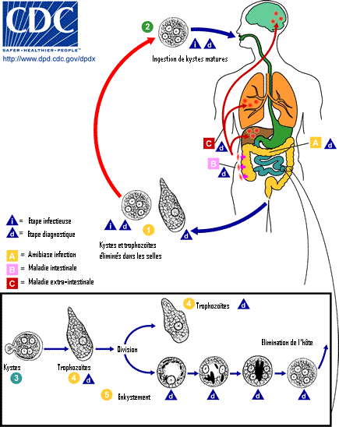
Reservoir
Carried asymptomatically in digestive tract of humans.
  Primary: Lumen of colon and caecum
  Secondary: Extraintestinal locations
    Liver, lung, brain, skin, other tissues
Not found in animals
  Microbe was discovered through experimentation on a canine
This Photo by Unknown Author is licensed under CC BY-SA

Slide 23
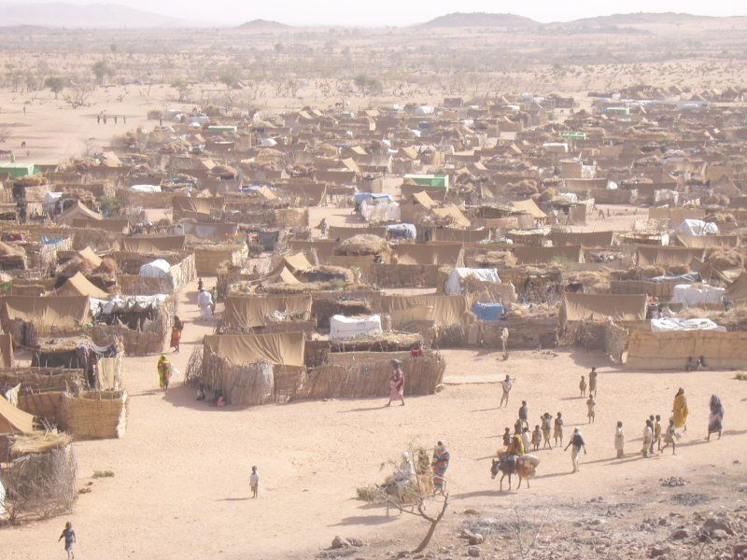
Host Range
Humans
  Poor sanitation habitat
  Male homosexuals
  Travelers/recent immigrants
  Institutionalized populations
Primates
This Photo by Unknown Author is licensed under CC BY-SA

Slide 24
Risks
Predisposing
Occupational
Location
Age
Ingestion of raw vegetables
Water quality
Number of rooms/bedrooms per home
Previous infection of protozoan
Medical facilities
Power plant
Missionaries
Health care
Sewege plants
Notes:
http://www.sciencedirect.com/science/article/pii/S0035920305000647

Slide 25
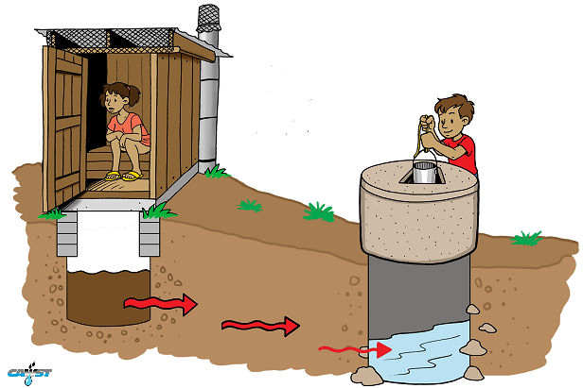
Mode of Transmission
Ingestion of contaminated food or water
  Fecal contaminant
  Amoebic cysts
Hand to hand transmission
  Contaminated surfaces
Sexual transmission
  Oral
  Anal
  From an asymptomatic carrier
  Chronically ill
This Photo by Unknown Author is licensed under CC BY-SA
Notes:
https://www2.health.vic.gov.au/public-health/infectious-diseases/disease-information-advice/amoebiasis

Slide 26
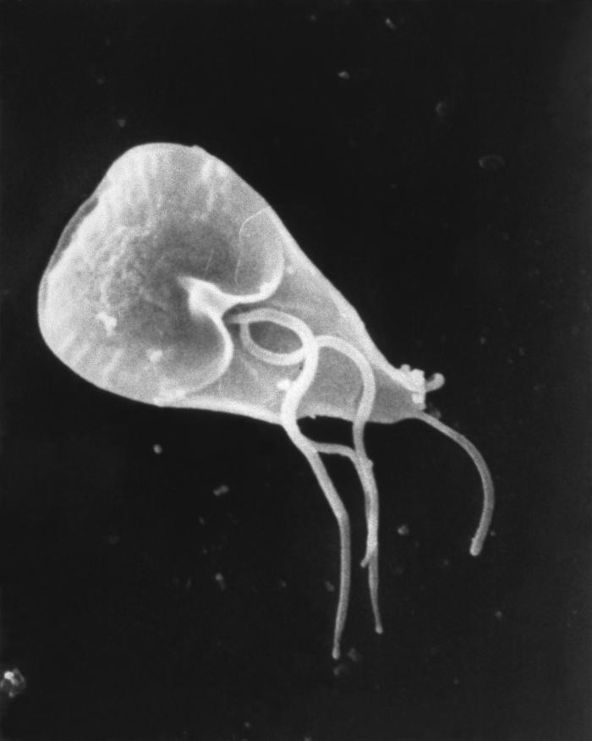
Protozoa:
Giardia lamblia
Melissa rios

Slide 27
History of G. lamblia
Giardia was first described by van Leeuwenhoek in 1861, while he was studying his own diarrheal stool samples under microscope.
In 1859, then described by Lambl, the human form was given the name G. lamblia.
Morphological criteria then used to distinguish G. Lamblia.
G. Lamblia became widely accepted as species name in 1970s.

Slide 28
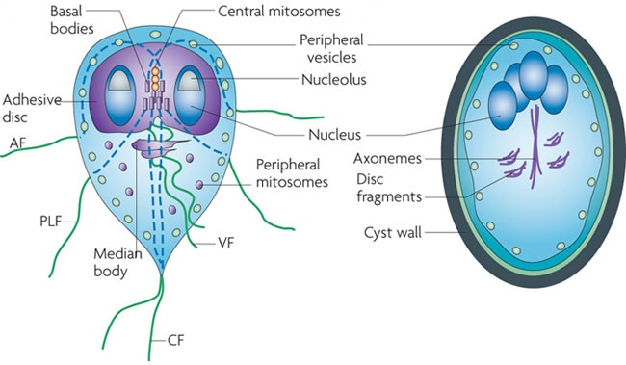
G. lamblia
Most prevalent parasitic protest in the United States
Eukaryotic, with nucleus, nuclear membrane, cytoskeleton, and endomembrane system.
Anaerobic
Lacks mitochondria

Slide 29
Where is G. Lamblia found?
Most prevalent in United States, can be naturally found in mountain streams and river
Can be found world-wide in human and mammals ex: cats, dogs, cattle, deer, and beavers.
Most commonly found in people who have poor fecal-oral hygiene.
Found on surfaces, in soil, food, and water that have been contaminated with fecal matter from already infected humans or animals.

Slide 30
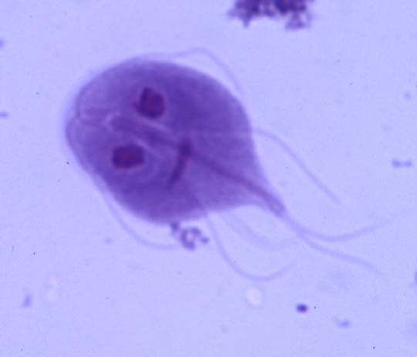
Mode of transmission
If a person swallows objects that came in contact with fecal matter (pathogen) they become infected.
Fecal-Oral Route
Drinking contaminated water.
Is contagious from person to person.
Can be spread through sexual activity.

Slide 31
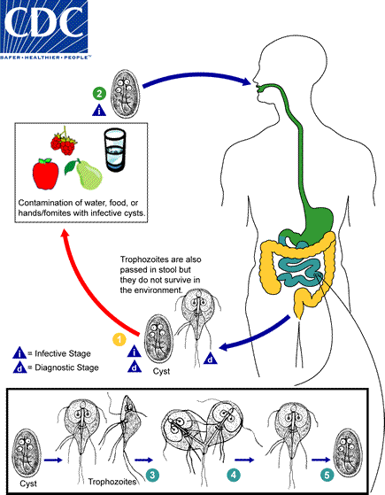

Slide 32
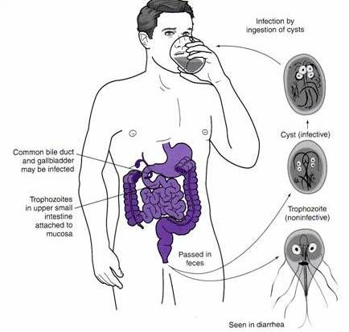
Infectious Dose
Cysts are the resistant forms of Giardia Lamblia and are responsible for transmission.
Once cysts are ingested, in the small intestine each cyst produces two trophozoites.
Trophozoites multiply by binary fission.
Low infectious dose: host can be infected with as little as 10 cysts.

Slide 33
Predisposing & Occupational Risks Disease
Children or workers in daycare settings
Travelers
Poor hygiene
Backpackers or campers
Homosexual Men

Slide 34
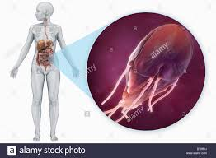
Reservoir
Pathogen is found in feces of infected mammals and humans. Feces can contaminate food, soil, and water.
Once in the body parasite lives within the intestines, more specifically small intestine.
It infects nearly 2% of adults and 6%-8% of children in developed countries worldwide.
Nearly 33% of people in developing countries have had giardiasis.

Slide 35
Host Range
Humans
Mammals (mostly bears and beavers)

Slide 36
Work Cited
http://www.gastrojournal.org/article/S0016-5085(74)80074-0/pdf
http://cmr.asm.org/content/14/3/447.full
https://www.cdc.gov/parasites/giardia/pathogen.html
http://www.austincc.edu/microbio/2704q/gl.htm

Slide 37
Toxoplasma gondii
Clarisa Salinas

Slide 38
Where does it naturally live? Soil? Natural environment?
Found in soil or sand that has been contaminated with cat feces.
Found in raw or undercooked meat.
Found in the feces of domestic cats.
Toxoplasma is an intracellular protozoan parasite.

Slide 39
Region found.
Worldwide
Infects about 1/3 of the human population
An estimated 15% - 85% of adults have a chronic infection, depending on where they live.
Higher prevalence of oocysts in the environment in moist and hot regions than in dry or cold regions.

Slide 40
Reservoirs
Tissue cysts found in animal meat.
Resistant oocysts found in cat feces.

Slide 41
Host Range
Warm blooded vertebrae
Includes most mammals and birds.
Cats and other members of Felidae (excrete resistant oocytes in their feces)
Can be contracted by humans when cleaning a litter box (particles fly up into the air)
Flies and cockroaches that have fed on infected cat feces can transmit oocysts to food in their own feces.
Human ingestion of persistent asexual stages (bradyzoites) residing in the tissues of intermediate hosts (e.g. pigs, goats, sheep etc.)

Slide 42
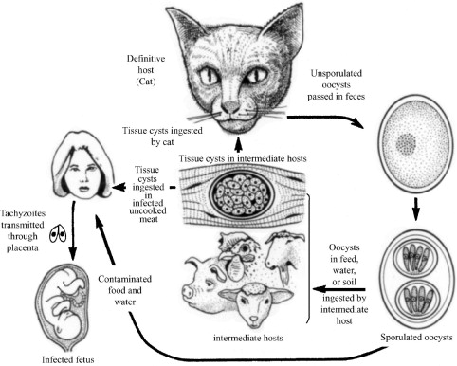

Slide 43
Notes:
Another diagram to show the mode of transmission.

Slide 44
Predisposing and Occupational Risks
Pregnant woman and their infant.
Working in a garden that has been contaminated with cat feces.
Cats
Immunocompromised individuals (e.g. AIDS, lupus, rheumatoid arthritis, Chrohn’s disease, etc.)
Not properly washing hands after handling uncooked meat.

Slide 45
Disease
Toxoplasmosis
Mostly asymptotic in adults. The immune system is able to over come it.
Can be confused for the flu. Symptoms of acute infection include fever, rash, headache, lymphadenopathy, weight loss, weakness, pneumonia. Chronic infection can include retinochoroiditis (infection and inflammation in the back of the eye) and severe encephalitis (inflammation of the brain).
Pregnant woman who get infected are not usually affected, however their infant can suffer health defects. The infant can suffer mental retardation or blindness. Persistent tissue cysts in the brain can result in psychosis.

Slide 46
Infectious dose
As few as 10 unsporulated oocysts in intermediate hosts.
Process of infection:
Oocyst-containing two sporocysts and four sporozoites each, quickly-multiplying tachyzoites, and slow-growing bradyzoites contained in persistent tissue cysts.
Infection is most often initiated through the ingestion of oocysts containing sporozoites or cysts containing bradyzoites in contaminated food or water.
Following ingestion, the sporozoites or bradyzoites invade the intestinal epithelium and differentiate to tachyzoites, which disseminate and replicate within the new host.
In feline infections, T.gondii sexual reproduction is enteroepithelial and asexual reproduction is extraintestinal. Intermediate hosts only experience extraintestinal infection
Notes:
https://www.canada.ca/en/public-health/services/laboratory-biosafety-biosecurity/pathogen-safety-data-sheets-risk-assessment/toxoplasma-gondii-pathogen-safety-data-sheet.html

Slide 47
Mode of transmission
Consuming raw or undercooked meats (pork, beef)
Ingestion of water, food, or milk contaminated with oocysts.
Inhalation of aerosols containing oocysts.
Contact with sand or soil (litter) contaminated by cat feces (indirect form)
Congenital infection: if mother has an acute infection during pregnancy. Although the mother may be asymptomatic, lesions can present in the placenta, which can in turn infect the fetus.
Blood transfusions and organ transplants (direct form)
Tainted water
Unwashed raw vegetables or fruits also increases risk of infection.
Children can be infected via contaminated sandboxes or playgrounds.

Slide 48
Works Cited
https://www.canada.ca/en/public-health/services/laboratory-biosafety-biosecurity/pathogen-safety-data-sheets-risk-assessment/toxoplasma-gondii-pathogen-safety-data-sheet.html
http://www.iaff.org/HS/Resi/infdis/What_are_the_modes_of_transmission.htm
http://www.sciencedirect.com/science/article/pii/S1198743X1462509X#bib1
http://journals.plos.org/plospathogens/article?id=10.1371/journal.ppat.1002567
https://www.ncbi.nlm.nih.gov/books/NBK7752/

Slide 49
Protozoa: Cryptosporidium
Christian Macias

Slide 50
-Where does it naturally live? Soil ? Natural environment.
Cryptosporidium (crypto) is a unicellular eukaryotic cell that falls under the parasitic protozoa family and the Apicomplexa phytlum. Crypto can be virtually be found in all parts of the world. It is commonly found in fecal matter and areas that fecal matter can be found which include but not limited to soil, water, fecal samples, etc.

Slide 51
-Region where it can be found
Although crypto can be found in many places, it has predominantly been reported to infect individuals that are exposed to recreational water. Also 3rd world countries (developing countries) are higher susceptible to infection since their water treatment isn’t as efficient in eliminating pathogens from the water. Currently there are various projects that hope to innovate and make the water treatment more efficient and cost effective.

Slide 52
-Reservoir
Can be found in natural bodies of water (lakes, rivers, ponds etc.) as well as artificial bodies of water ( pools, man made lakes, dams etc.)

Slide 53
-Host Range
C.parvus and C. huminis are variations of crypto. These two are the main pathogens that infect humans. Patients with an immune compromised system are at higher risk for infection and illness severity is also higher.

Slide 54
-Predisposing & Occupational Risks Disease?
Individuals who work directly with stool samples or anywhere where fecal matter may be present should take extra precaution. As recommended by the CDC the most effective way to prevent further infection is by handwashing with soap. Although crypto can target several site with in the body; G.I infections are the most common infections reported.

Slide 55
-Infectious Dose?
After several experiments it has been determined that the infectious dose varies amongst the genetic variation of the crypto strand. C. parvus and C. huminis are the variation that is found in most humans and animals.
In one study to determine the infectious does (ID50) of C. huminis, it was determined that dose of infection ranged from 10-500 (TU502) oocysts. Symptoms of infection varied with oocyst concentration.

Slide 56
-Mode of transmission?
Mode of transition can be either direct or indirect. An example of direct infection is when fecal matter containing the shedding of crypto comes into contact with an individual’s mouth. An example of indirect is when an individual ingest water that has been contaminated with crypto by another individual. Common signs and symptoms usually associated with infection can include nausea, vomiting, watery diarrhea, weight loss, abdominal pain and fever.

Slide 57
Works Cited
“Sources of Infection & Risk Factors.” Centers for Disease Control and Prevention, Centers for Disease Control and Prevention, 1 Apr. 2015, www.cdc.gov/parasites/crypto/infection-sources.html.
Jex, Aaron R., et al. “Classification of Cryptosporidium Species from Patients with Sporadic Cryptosporidiosis by Use of Sequence-Based Multilocus Analysis following Mutation Scanning.” Journal of Clinical Microbiology, American Society for Microbiology (ASM), July 2008, www.ncbi.nlm.nih.gov/pmc/articles/PMC2446878/.
Yaeger, Robert G. “Protozoa: Structure, Classification, Growth, and Development.” Medical Microbiology. 4th edition., U.S. National Library of Medicine, 1 Jan. 1996, www.ncbi.nlm.nih.gov/books/NBK8325/.

Slide 58
Works Cited
Pandit, A B, and J K Kumar. “Clean Water for Developing Countries.” Annual review of chemical and biomolecular engineering., U.S. National Library of Medicine, www.ncbi.nlm.nih.gov/pubmed/26247291
“Host range.” Host range - Biology-Online Dictionary, www.biologyonline.org/dictionary/Host_range.
EPA, Environmental Protection Agency, 29 Oct. 2017, cfpub.epa.gov/ncer_abstracts/index.cfm/fuseaction/display.highlight/abstract/866/report/F

Slide 59
Works Cited
Bouzida, Maha, et al. “Maha Bouzid.” Clinical Microbiology Reviews, 1 Jan. 2013, cmr.asm.org/content/26/1/115.full.
Chappell, C L, et al. “Cryptosporidium hominis: experimental challenge of healthy adults.” The American journal of tropical medicine and hygiene., U.S. National Library of Medicine, Nov. 2006, www.ncbi.nlm.nih.gov/pubmed/17123976
Peng, M. M., et al. “Genetic polymorphism among Cryptosporidium parvum isolates: evidence of two distinct human transmission cycles.” Emerging Infectious Diseases, Centers for Disease Control, 1997, www.ncbi.nlm.nih.gov/pmc/articles/PMC2640093/.

